Slide 1
Classroom, Workplace and Beyond!
Kate Kaegi and Paula Martin

Slide 2
What we’re going to talk about
Etiquette
Self Disclosure
Silent Disabilities
Autism
Learning Disabilities
Mental Health Disorders
Accommodations

Slide 3
Etiquette
Its all about respect…
If you’re unsure of anything – Ask
Don’t Assume anything – Someone will always surprise you
Talk to an adult like they are an adult
Don’t patronize

Slide 4
Self Disclosure
What is this?
Why would this be difficult for individuals with disabilities?
When would Self Disclosure be recommended?

Slide 5

Asking difficult questions or Can you?

Slide 6
Autism Spectrum Disorder (ASD)
Is a developmental disorder that can cause significant social, communication and behavioral challenges.
There is often nothing about how people with ASD look that sets them apart from other people, but people with ASD may communicate, interact, behave, and learn in ways that are different from most other people.
https://www.cdc.gov/ncbddd/autism/facts.html

Slide 7
Autism Spectrum - Strengths
Tend to be visual learners
Skilled rote memory
Math skills tend to be high
Diverse perspective to problem- solving
Can be meticulous with their work
Eye for detail
Uniquely logical way of thinking – arrive at practical solutions

Slide 8
Autism Spectrum - Underdeveloped
Academic Skills
Self Care
Social Competence
Self Advocacy
Career Preparation

Slide 9
Mental Health Conditions
What are the 10 characteristics of people who are mentally healthy (according to the National Mental Health Association)?
Name some mental health disorders…

Slide 10
Mental Health Conditions - Strengths
Can be managed with treatment and medication
Cyclical
Varying impacts and issues
Many know and recognize their symptoms and address problems quickly

Slide 11
Mental Health Conditions - Signs
Confused thinking
Prolonged depression (sadness or irritability)
Feelings of extreme highs and lows
Excessive fears, worries and anxieties
Social withdrawal
Dramatic changes in eating or sleeping habits
Strong feelings of anger
Strange thoughts and /or hallucinations (seeing/hearing)
Growing inability to cope with daily problems and activities
Suicidal thoughts
Numerous unexplained physical ailments
Substance use

Slide 12
Learning Disabilities
A neurological condition that interferes with an individuals ability to store, process or produce information.
Learning disabilities an affect one’s ability to read, write, speak, spell, computer math, and also affect an individual’s attention, memory, coordination, social skills and emotional maturity.
Source: Learning Disabilities association of America

Slide 13
LD Characteristics
The learning issue itself that can make academic skill learning difficult in all situations
Secondary issues of mental health difficulties (low self esteem and poor self concept)
Notes:
Source: http://www.ldonline.org/article/5998/

Slide 14
Types of Learning Disorders
Dyscalculia
Dysgraphia
Dyslexia
Auditory Processing Disorder (APD)
Language Processing Disorder
Non-Verbal Learning Disabilities
Visual Perceptual/Visual Motor Deficit

Slide 15
Related Disorders
ADHD
Dyspraxia
Executive Functioning
Memory
FYI – non of these are considered Learning Disorders…

Slide 16

Questions and Feedback

Slide 17
Accommodations
What is it?
How much does it cost?
Where do you find it?

Slide 18
Issues that may Develop
Screening out environmental stimuli
Sustaining concentration
Maintaining stamina
Handling time pressures and multiple tasks
Interacting with others
Responding to negative feedback
Notes:
Screening out environmental stimuli– an inability to block out sounds, sights, or odors which interfere with focusing on tasks
Ex. An employee may not be able to work next to a noisy printer or in a high traffic area.
Possible solutions: Move printer away from work area, allow employee to wear headphones playing soft music, install high partitions around desk.
Sustaining concentration– restlessness, shortened attention span, easily distracted, trouble remembering verbal directions
Ex. An employee may have trouble focusing on one task for extended periods.
Possible solutions: Break large projects into smaller tasks, allow brief but more frequent breaks to stretch, walk around, get fresh air, assign tasks one at a time.
Maintaining stamina– having energy to work a full day, combating drowsiness due to medications
Ex. An employee may not be able to work a full 8 hour day.
Possible solutions: Part time hours, rest breaks in middle of day, job sharing.
Handling time pressures and multiple tasks– managing assignments & meeting deadlines, prioritizing tasks
Ex. An employee may not know how to decide which tasks should be done first, or be able to complete tasks by the due date.
Possible solutions: Break larger projects down into manageable tasks, meet regularly to help the employee to prioritize tasks or to estimate time to complete project.
Interacting with others– getting along, fitting in, talking with coworkers, reading social cues
Ex. An employee may not talk with coworkers at breaks, or may have trouble reading the subtle social cues of the workplace.
Possible solutions: Establish a mentor or coworker buddy relationship to introduce the employee to others or to show the employee “the ropes”.
Responding to negative feedback– understanding and interpreting criticism, knowing what to do to improve, initiating changes because of low self esteem
Ex. An employee may not seem to understand the feedback given, or becomes upset when criticism is delivered.
Possible solutions: Arrange a meeting with the job coach and employee to facilitate feedback, use a feedback loop (ask employee’s perspective of performance, describe both strengths and weaknesses, suggest specific ways to improve), give employee the chance to read written feedback privately, and then discuss.

Slide 19
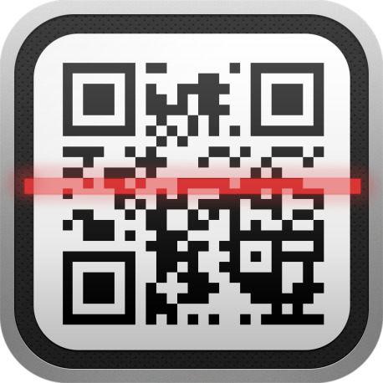


Reading Accommodations
Bar code scanner
QR Scanner
Screen Readers

Slide 20
Alternative Input Devices
Alternative Electronic pointing
Sip-and-puff
Wands and Sticks
Joysticks
Trackballs
Touch Screen

Slide 21
Maintaining Concentration Audibly
Determine if working alone is possible (rather then in groups or relocate staff to minimize
Music, white noise, noise canceling headset (if allowed)
Use sound absorption panels

Slide 22
Reduce Visual Distractions
  Space enclosures
  Reduce clutter
  Redesign or Relocate office
  Provide visual

Slide 23
Organization Assistance:
Weekly chats
Job coach to teach/reinforce organization skills
Mentors
Provide help prioritize tasks
Help prioritizing
Provides “Cheat sheet”

Slide 24
Speaking / communication
Topic switching
Specific instructions for meetings
Allow written responses
A friend / advocate for meetings / performance reviews

Slide 25
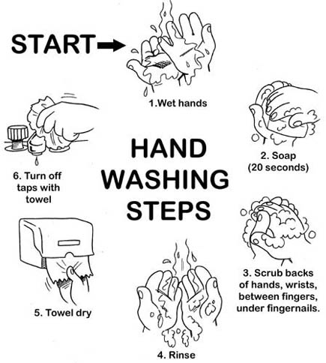
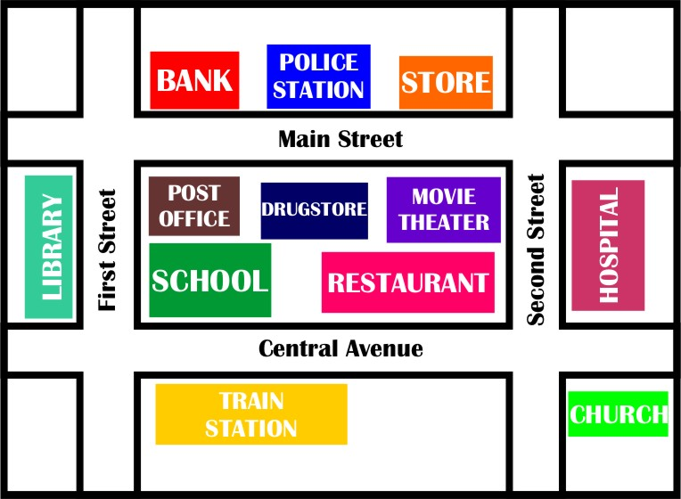
Picture instructions

Slide 26
Atypical Body Movements
Provide structured breaks to create an outlet for physical activity
Sensory items
Telecommuting
Scheduled Breaks
Review Conduct Policy
Adapting the environment

Slide 27
Time Management:
Divide large assignments into several small tasks
Timers
Checklist
Electronic or handheld
Wall calendars

Slide 28

Memory
Additional time
Refreshers
Verbal cues
Flowcharts
Picture Cues
Post-it Notes
Timer for reminders
Apps

Slide 29
Stress Management
Praise and positive reinforcement
Allow employee to make telephone calls for support
Provide sensitivity training for workforce
Support animal
Modify work schedule

Slide 30


Sensory
Fragrance sensitivity- good air flow,
air purification systems, etc.
Light sensitivity – move to a different area, provide colored glasses
Noise sensitivity – mask distracting sounds, move employee away from office noise if possible

Slide 31
Company Structure
Provide review of policy
Adjust method of supervision
Give concrete examples and consequences
Use Employee Assistance Program if available

Slide 32
Apps
Fine Motor
  Dexteria Android ($9.99) and iOS ($3.99)
  Visual Perceptual Skills
  Rush Hour Android and iOS Free
  Communication / Accommodation
  Dragon Dictate Android (free) and iOS (free)
  Snap Type iOS free

Slide 33
Apps
  Social Participation
  First Then Visual Schedule Android ($4.99) and iOS ($9.99)
  Time Management and Organization
  Toodledo: Android (free) and iOS ($2.99)
MyHomework Student Planner: Android (free) and iOS (free)

Slide 34

Apps to Reduce Stress in the Moment
SAM Self-help Anxiety Management
Sosh Relax
Breathe2Relax
Colorfy, Recolor
MyCalmBeat

Slide 35
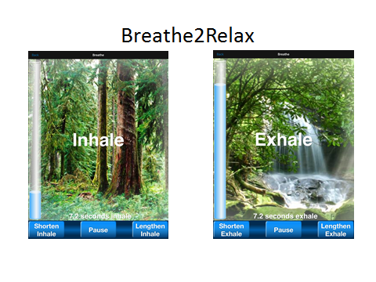

Slide 36
Task List Apps
Reminders: iOS
Any.Do: iOS, Android, web
Others to review: Sloth - Task Manager, Focus

Slide 37
It's not about the apps...
But supporting the person's needs through technology.

Slide 38
Accommodation Resources
Department for Aging and Rehabilitation Services – DARS
Assistive Technology Evaluation
Disability Services at the college
Virginia Assistive Technology Services – VATS
AT Loan fund

Slide 39
References
JAN – Job Accommodation Network www.askjan.org
School-Based Occupational Therapists’ Perspectives on Using iPads
Clabia, M., Collins, A., Cully, K., Keys, D., & Pagnotta, K. (2016). School-based occupational therapists’ perspectives on using iPads. OT Practice, 21(18), 18–21
Panicked to Productive
Carrie Clawson, OTR/L, ATP
Assistive Technology Specialist Virginia Dept for Aging and Rehab Services
NAMI, the National Alliance on Mental Illness

Slide 40

Questions and Feedback

Slide 41
Kate Kaegi
Kate.kaegi@dars.virginia.gov
Paula Martin
paula.martin@dars.virginia.gov

